Slide 1
ADVANCED MACHINE LEARNING END TERM
Developing an SMS Spam Filter
TEAM – 11
D22014 – Chothani Jay Rameshbhai
D22017 – Gowtham Kumar
D22018 – Himanshu Yadav
Course: AML

Slide 2
DATA PRE-PROCESSING
Raw SMS Data
Removal of Stop words and white spaces
Removal of punctuation
Cleaning text for white spaces
Tokenization
Lemmatization
Stemming

Slide 3


WORD CLOUD
Ham SMS
A word cloud for Ham SMS and Spam SMS typically reveals the most frequently used words in the spam and ham messages.These words are usually chosen based on their importance and can provide insights into the themes and tactics used by spammers.
From the ham word cloud, we can observe that the words like go, come,love,know,see,dont ,hope,good etc have appeared frequently.
From the spam word cloud, we observe that words like call,claim,free,send,week,reply etc have appeared frequently.
Spam SMS

Slide 4
Vectorization approach - TF
The CountVectorizer is used to create the bag of words model
From the text corpus we will convert down the words based on their frequency
Finally converting the corpus into DTM (Document Term Matrix)
Pre-processed SMS data
Count –Vectorizer to create BOW
Term Frequency
Converting into DTM

Slide 5
Vectorization approach – TF - IDF
The TF-IDF Vectorizer is used to compute the score for each SMS
From the text corpus we will convert down the words based on their TF-IDF into Array
Finally converting the corpus into TF-IDF Matrix
Pre-processed SMS data
TF-IDF Vectorizer to compute score for each word
Computation of TF-IDF array for full corpus
Converting into TF-IDF DataFrame

Slide 6
Vectorization approach – Word2Vec
The Google word2vec embeddings are available which contain huge corpus of words.
From the text corpus we will consider each word and convert them into 300 dim vector based on the similarities of the words in the Google word2vec corpus.
Finally converting the individual vectors for all SMS into a Dataframe
Google word2vec embeddings
Finding vector for each word in corpus
Each SMS will be converted into 300 dim vector
Converting into 300 dim vector of corpus to DataFrame

Slide 7
Vectorization approach – Heuristic
The Presence of Phone No was considered as the heuristic feature
Created the user defined function to identify the presence of phone number in the SMS
Finding any presence of heuristic feature in the corpus
Creating a column for the heuristic feature
Considering the created heuristic feature to classify the SMS

Slide 8
Dimensional Reduction
In our exercise we are using two methods for dimension reduction.
1) PCA - In PCA we'll be keeping the number of components that explains at least 95% of the overall variance.
2) Dimension reduction by proportion - In reduction by proportion we’ll remove terms that is contained in less than 0.01% of the documents

Slide 9
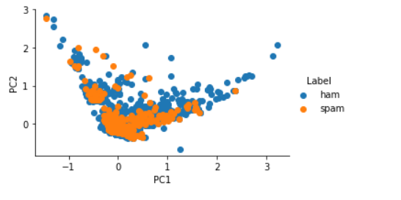
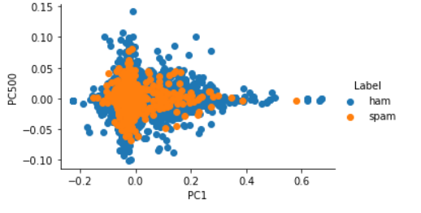
Dimensional Reduction PCA Visualization
TF Vectorization Approach
TF-IDF Vectorization Approach

Slide 10
MODEL-1
ham
spam
Aim: To perform classification to perfectly classify the ‘spam’ SMS or ‘normal’ SMS
Experiment – This model is for the TF-PCA Vectorization, on Logistic Regression model
Observations – The confusion matrix and the performance metrics of the fitted model for the validation is estimated.
Performance metrics:
F1_score = 0.909
Recall Score = 0.841
Accuracy = 0.982
Precision = 0.988
867 | 1
16 | 85
ham
Actual
spam
Predicted

Slide 11
MODEL-2
ham
spam
Aim: To perform classification to perfectly classify the ‘spam’ SMS or ‘normal’ SMS
Experiment – This model is for the TF Vectorization, on logistic regression model
Observations – The confusion matrix and the performance metrics of the fitted model for the validation is estimated.
Performance metrics:
F1_score = 0.90
Recall Score = 0.83
Accuracy = 0.98
Precision = 0.98
867 | 1
17 | 84
ham
Actual
spam
Predicted

Slide 12
MODEL-3
ham
spam
Aim: To perform classification to perfectly classify the ‘spam’ SMS or ‘normal’ SMS
Experiment – This model is for the TF-PCA Vectorization, on bagging Classifier model
Observations – The confusion matrix and the performance metrics of the fitted model for the validation is estimated.
Performance metrics:
F1_score = 0.85
Recall Score = 0.82
Accuracy = 0.98
Precision = 0.89
856 | 12
23 | 78
ham
Actual
spam
Predicted

Slide 13
MODEL-4
ham
spam
Aim: To perform classification to perfectly classify the ‘spam’ SMS or ‘normal’ SMS
Experiment – This model is for the Word2vec Vectorization, on SVC model
Observations – The confusion matrix and the performance metrics of the fitted model for the validation is estimated.
Performance metrics:
F1_score = 0.87
Recall Score = 0.84
Accuracy = 0.97
Precision = 0.93
864 | 4
17 | 84
ham
Actual
spam
Predicted

Slide 14
MODEL-5
ham
spam
Aim: To perform classification to perfectly classify the ‘spam’ SMS or ‘normal’ SMS
Experiment – This model is for the word2vec Vectorization, on Random Forest Classifier model
Observations – The confusion matrix and the performance metrics of the fitted model for the validation is estimated.
Performance metrics:
F1_score = 0.85
Recall Score = 0.77
Accuracy = 0.98
Precision = 0.95
864 | 4
23 | 78
ham
Actual
spam
Predicted

Slide 15
MODEL-6
ham
spam
Aim: To perform classification to perfectly classify the ‘spam’ SMS or ‘normal’ SMS
Experiment – This model is for the TF Vectorization, on Random Forest Classifier model
Observations – The confusion matrix and the performance metrics of the fitted model for the validation is estimated.
Performance metrics:
F1_score = 0.84
Recall Score = 0.73
Accuracy = 0.97
Precision = 1
868 | 0
27 | 74
ham
Actual
spam
Predicted

Slide 16
MODEL-7
ham
spam
Aim: To perform classification to perfectly classify the ‘spam’ SMS or ‘normal’ SMS
Experiment – This model is for the TF-PCA Vectorization, on gradient boosting classifier on model
Observations – The confusion matrix and the performance metrics of the fitted model for the validation is estimated.
Performance metrics:
F1_score = 0.83
Recall Score = 0.82
Accuracy = 0.96
Precision = 0.85
854 | 14
18 | 83
ham
Actual
spam
Predicted

Slide 17
MODEL-8
ham
spam
Aim: To perform classification to perfectly classify the ‘spam’ SMS or ‘normal’ SMS
Experiment – This model is for the TF-IDF Vectorization, random forest classifier on model
Observations – The confusion matrix and the performance metrics of the fitted model for the validation is estimated.
Performance metrics:
F1_score = 0.83
Recall Score = 0.7
Accuracy = 0.97
Precision = 1
868 | 0
28 | 73
ham
Actual
spam
Predicted

Slide 18
MODEL-9
ham
spam
Aim: To perform classification to perfectly classify the ‘spam’ SMS or ‘normal’ SMS
Experiment – This model is for the TF-PCA Vectorization, on random forest classifier
Observations – The confusion matrix and the performance metrics of the fitted model for the validation is estimated.
Performance metrics:
F1_score = 0.83
Recall Score = 0.73
Accuracy = 0.97
Precision = 0.97
866 | 2
27 | 74
ham
Actual
spam
Predicted

Slide 19
MODEL-10
ham
spam
Aim: To perform classification to perfectly classify the ‘spam’ SMS or ‘normal’ SMS
Experiment – This model is for the TF-PCA Vectorization, on support vector classifier
Observations – The confusion matrix and the performance metrics of the fitted model for the validation is estimated.
Performance metrics:
F1_score = 0.88
Recall Score = 0.83
Accuracy = 0.97
Precision = 0.95
864 | 2
17 | 84
ham
Actual
spam
Predicted

Slide 20
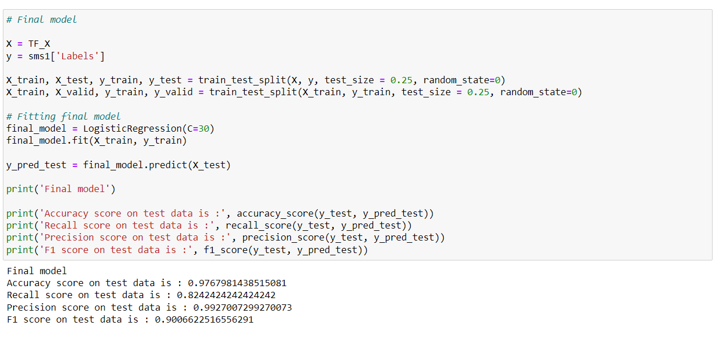
BEST PERFORMING MODEL

Slide 21
CONCLUSION
Out of all the models, we got F1 score of 0.90 for TF-Vectorization with Hyperparameter tuned
The Top performing models apart from the best model are tabulated above detailedly
The selected best performing model out of all has got 0.92 f1 score. properly classifying the spam and ham SMS.
The overfitting and underfitting in the model were taken care with hyperparameter tuning
The precision score on the data is 99.2%
The Accuracy score is 97.6%
The exercise was thoroughly done on the dataset of SMS spam detection to correctly classify whether a message is spam or ham, Various text pre-processing, vectorization and dimensionality reduction was considered to drive the best possible results. Further the analysis can be concentrated on the aspects of finding more heuristic features in the messages to classify the SMS. In this work, we have considered the "presence of phone No" as a heuristic feature, there is scope to identify more features to improve our classification accuracy.

Slide 22
Thanks!

